Slide 1
Blended Finance in India
A decade of Blended Finance
in India and what lies ahead
September 2023
Aparna Dua
Director, Asha Impact
Tushar Thakkar
Associate Partner, Dalberg Advisors

Slide 2
What is blended finance?
Focus on commercial returns
Focus on impact
Commercial investing
ESG / SRI investing
Impact Investing
Blended finance
Traditional philanthropy
Uses development finance and philanthropic funds to attract private capital into deals
Leverage
Includes investments that drive social, environmental & economic progress
Provides financial returns for private investors based on real & perceived risks
Impact
Returns
Blended finance is a tool in the fund-raising team & funder’s armory – a significant proportion of very important interventions, that are in the nature of public goods and might be perceived to be highly risky by private capital still need to be and should be served by grants

Slide 3
Blended finance encompasses a broad range of instruments
 | Concessional finance | Guarantees / Risk insurance | Results-based financing | Technical assistance grants
Description | Development funder* provide funds on below-market terms to reduce risk or improve return for private investors | Development funder* by acting as a guarantor or by absorbing a portion of losses to mitigate risks | Development funder* only provides funding if impact targets are met, or provides an incentive for meeting impact targets | Development funder* provides support to strengthen investees and improve project viability
Examples | Concessional debt Concessional equity | Partial / full loan Guarantees First loss capital | Development / social Impact bonds Social success notes / interest subvention | Feasibility studies Grants for setting up business processes / capacity building etc.
Simpler structures such as guarantees (1 in 2 transactions) and concessional & subordinate debt see substantial traction and higher transaction size
Results-based financing transactions are typically smaller but focused on driving innovations and changing incentives – significant and expanding focus on mainstreaming
TA and design grants - critical role in driving growth and innovation

Slide 4
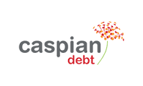
The Blended Finance market in India has been growing steadily
USD 5.6 Billion has been deployed across ~180 transactions between 2010-22
Annual investments 2010-22 (USD Mn)
CAGR
+19%
2010
2012
2014
2016
2018
2019
2020
2022
Bilateral agencies / DFIs and international foundations are active development funders
NBFCs and Banks are prominent private investors
3
Notes:
Blending in trending! – the market in India crossed 1bn last year , Projected to reach 2.6Bn by 2027 – conservative estimates
Ground up exercise – hence we believe the true size could be ~20-25% higher
3.4% of cumulative global market / 160 Bn in the last decade – as per convergence
Of 5.6Bn, 80% commercial and 20% concessional
14 BF transactions annually / Global average 55
BLENDED FINANCE MARKET IS AT A NASCENT STAGE, PRESENTS MODERATE-RISK, LOW-RETURNS, AND HIGH-IMPACT OPPORTUNITY

Slide 5
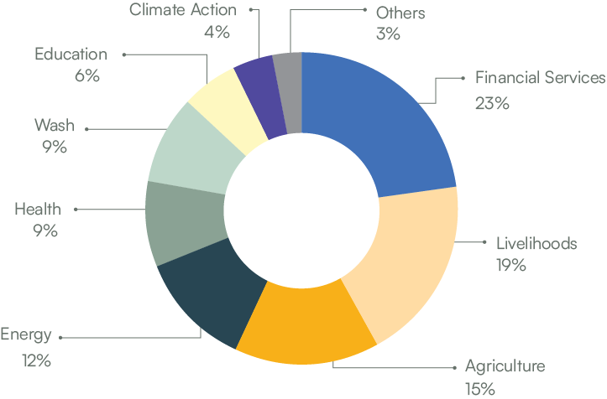
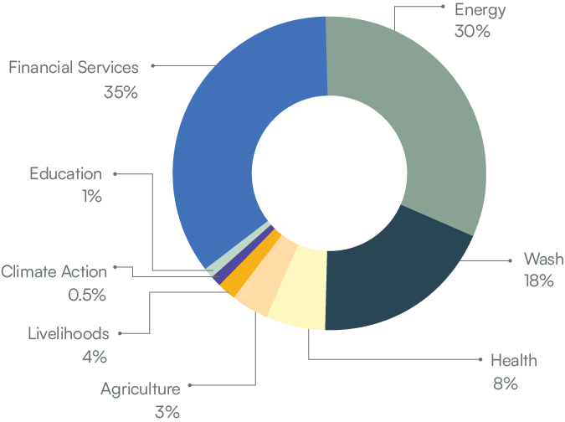
Blended Finance Market by Sector
Financial Services and Energy ~65% of market
Total Market Size by Sector (Volume)
Total Market Size by Sector (Value)
As per industry survey, FS and Energy will continue to lead the market and Agriculture, Healthcare and Livelihoods will see increased traction. Education is leading the field in results-based financing
4
Notes:
Fairly good distribution by volume
By value – similar to global trends
financial services sector’s amenability to simpler credit enhancement structures like first-loss guarantee and subordinated debt. Overall, among development sectors, it is relatively the most mature, regulated, and well-funded.
The energy sector has seen a global thrust, especially for renewable and clean energy projects. In India 2070 – net zero target

Slide 6
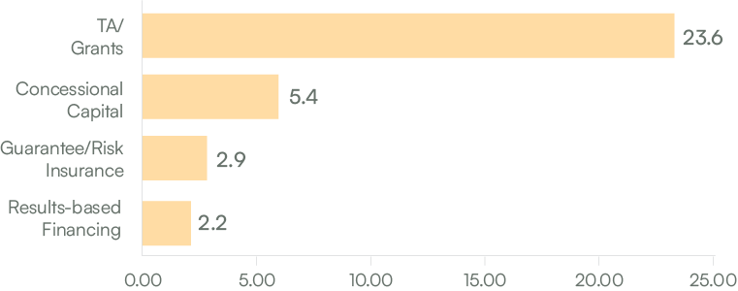
Learnings from early trends: Expansion of capital for important causes
Overall leverage of catalytic capital is 5.06x
Concessional Capital structures mostly in Financial Services and Energy – mature business models allow for greatest efficiency and leverage
Guarantees may have higher leverage in practice, however, most transactions have been structures with 30-50% guarantees
RBF instruments instrumental in creating evidence of what works on-ground, creating pathways for much greater leverage and scale
Catalytic capital has been able to co-opt significant commercial capital
5
Notes:
critical measures of success of a BF transaction is the extent of leverage
As per the IFC’s calculations based on DFI self-reported data, DFI’s leverage of concessional amount for lower-middle-income countries (with income levels comparable to India) was 5.4x during 2017–2018.
Guarantees – scope for higher leverage. In practice for guarantees could be higher – this is a conservative estimate calculated assuming the entire catalytic amount is reserved for the guarantee, however in practice, it may only be a fraction

Slide 7
Focus instrument: Results-based financing can be particularly impactful in the right conditions
Results-based financing is most suitable when:
Improves effectiveness of development programmes
Outcomes are well-defined, measurable, attributable to the project and can be achieved in a reasonable timeline
Data is available (including baseline data) for outcomes measurement
Improves the efficiency of government and donor spending
Capacity of various consortium members to operate under a rigorous results-oriented framework
Problem is big enough to justify costs of designing, monitoring and managing a blended finance transaction
Creates evidence of what works
Interventions have been demonstrated, even if at only a pilot stage

Slide 8
Case Studies of Results-based financing (1/2)
India Skill Impact Bond
QEI Development Impact Bond
The Skill Impact Bond is India’s first outcomes-based transaction focused on skilling and employment. It aims to strengthen India’s technical and vocational education system and support 50,000 youth, 60% of whom will be women.
Investors: NSDC, MSDF
Outcome funders: CIFF, JSW, HSBC, Dubai Cares
Payment metric: Emphasis on placement & retention
Size: USD 14.4 Mn
The Quality Education India Development Impact Bond (QEI DIB) is the largest education DIB in the world and supports Indian education providers in improving learning outcomes for primary school children.
Investors: UBS Optimus foundation
Outcome funders: MSDF
Payment metric: Increased literacy and numeracy
Size: USD 11 Mn
Current Impact
18,000+ Impacted Participants | 70% Women enrollment rate
 | 18 States included in the program
Current impact
200,000+ Impacted Participants | 50% Higher learning outcomes
 | 2x Students achieving grade level proficiency
 | 8% ROI for investor

Slide 9
Case Studies of Results-based financing (2/2)
Health-tech Social Success Note
Utkrisht Impact Bond
The Social Success Note (SSN) will help innovative social enterprises scale and penetrate into regions with the highest need for healthcare services. Enterprises will receive loans from the investor. If they meet impact targets, the outcomes funder will reimburse a portion of the interest.
Investors: Caspian
Outcome funders: Samridh
Size: USD 4 Mn
The Utkrisht Impact Bond was the first impact bond globally to focus on maternal and newborn healthcare. It aims to improve the quality of maternal care in private healthcare facilities in Rajasthan by helping 440 small healthcare organizations meet and adhere to new government quality standards.
Investors: UBS Optimus foundation
Outcome funders: USAID, MSD for Mothers
Payment metric: NABH and Manyata accreditation
Size: USD 9 Mn
Intended impact
15+ High impact health solutions to be scaled | 8.3x Leverage on outcome funding
Current impact
450,000+ Impacted Participants | 400+ healthcare providers supported
 | 8% IRR for investor

Slide 10
Learnings from early trends: Deepening of impact for key developmental areas
Incentivization towards outcomes achievement has worked
The Skill Impact Bond is tracking to outcomes (3m retention in job) achievement of 2-3x (conservatively) of what the ecosystem, including other grant models, were delivering
Students under the Quality Education India impact bond learnt 2.5 times more than those in non-participating schools
Flexible funding, with simple outcomes focus, drives iteration and context-specific innovation
The Educate Girls Impact Bond had only achieved 50% of its learning targets at the second year. Using strong data systems and performance management, it revised its program design and achieved 160% of its learning target by the end of the third year.
Implementing non-profits have stepped up to drive sustainable success
Implementing partners that have been a part of outcomes-oriented structures have emphasized the transformation that they have gone through internally as well, supported by performance management
This capacity building will make impact sustainable
Aspirations are moving higher, focus on mainstreaming & systems change
As the proof of concept is proven, funders are now targeting larger scale of impact – looking to fund interventions (via RBFs) that transform systems and/or are amenable to large scale mainstreaming

Slide 11
Learnings from early trends: Early efforts have created a strong foundation for future expansion
Deeper understanding of what it takes (including costs) to achieve outcomes
The market now has experience in creating legal and financial structures
Robust MEL and data generation, along with well-defined learning agendas, are helping distil an understanding of what it takes to achieve targeted outcomes
E.g., successful application of RBF in education has helped identify the cost of achieving learning outcomes in various contexts.
This will help improve ecosystem understanding, influence mainstream programs, and provide the infrastructure to scale RBFs, where needed
As more structures are implemented, there is a greater understanding of the kinds of legal and financial structures, approaches and mechanisms that work
This has led to the creating of a core group of organizations, including non-profit actors, that now have a strong understanding of what it takes to set a transaction up for success, a key foundational element in facilitating future scale

Slide 12
The direction of travel is clear, with multiple new disruptors on the horizon
Social Stock Exchange
Regulatory frameworks such as SSE can help provide the necessary impetus by bringing more transparency in reporting, standardizing metrics and mobilising capital
Increasing focus from Government
“For encouraging important sunrise sectors such as climate action, deep-tech, digital economy, pharma and agri-tech, the government will promote thematic funds for blended finance”
Rising interest of capital allocators/ owners
Mainstream FIs such as banks, large NBFCs, impact funds in addition to DFIs increasing looking at blending as approach –80% of all capital mobilised till date in India
Bespoke structures to facilities
Sectors/ themes such as education, agriculture, healthcare, climate, WASH are ripe for scale and are moving away from bespoke structures to large scale facilities and funds

Slide 13
Learnings from early trends: Despite the significant progress, some challenges to scaling blended finance in India remain
Costs and complexities of structuring
c
Regulatory complexity and restrictions
Barriers to blended finance tools
Narrow application of current instruments
Lack of quality and standardized
data
Limited stakeholder awareness and capacity
Limited ways to bring together private and philanthropic actors
The challenges are especially difficult for implementation partners / non-profits to address. While there are several on-ground initiatives that could benefit from catalyzing blended finance, organizations face several barriers to initiating such transactions

Slide 14
Learnings from early trends: Transaction implementation needs to evolve substantially
1
Clearly outline key decision points and criteria for moving forward – do not be afraid to walk away
During the set-up stage
2
Identify the suitability of the financial instrument early on – no need to use a blended instrument where a grant will suffice
3
Bring key stakeholders together early in the design process – ensure design is collaborative and leverages everyone’s expertise
1
Create strong performance contracts anchored to core outcomes – align on core outcomes and the MEL process
During implementation
2
Plan ahead for “unknown knowns” – codify responses to events that could potentially disrupt the intervention

Slide 15
Unlocking blended finance in India will require a multi-pronged approach
Engagement with Government
Setting up an institutional framework - SSE
Advocacy toward legal and regulatory issues
Reduced cost of structuring
Building templatized models
Aiming for Scale
Data-driven and evidence based discussions - IBFC
Transparency and documentation
Building Awareness and Trust
14

Slide 16
Thank you

Slide 17
Key Issues Faced by Stakeholders
Notes:
Currently, most of the risks (pipeline related, impact related, etc.) are being managed through complex low-scale structures, leading to high transaction costs.
However, most market participants have shared that the BF market may have reached a turning point, where standardization of instruments, structures, and impact metrics can play a major role in improving the attractiveness of this segment.
Key challenges
Lack of awareness
Track record of impact and financial returns
Cost and time of structuring
Regulatory and legal issues

Slide 18
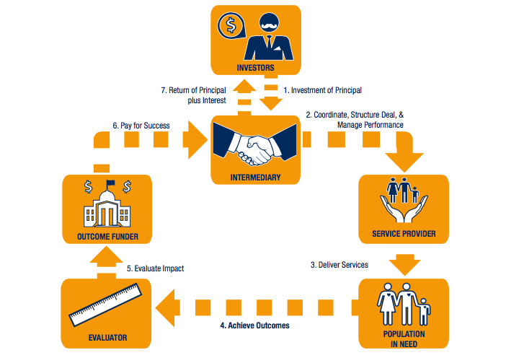
Social/Development Impact Bonds
Impact Bonds⁽¹⁾ are a contract between 3 parties – (a) Investor (b) Service Provider (c) Outcome Funder
The investor (aka Risk Investor) gives the Service Provider a working capital grant (Principal) to achieve pre-determined social outcomes.
If the Service Provider achieves these outcomes the investor receives the principal amount back with an interest payment, else the investor loses the Principal (akin to grant)
The outcome targets and the interest payment are determined upfront, at the time of contract signing, based on existing baseline data & negotiations
The Outcome Funder only pays on the achievement of outcomes which are measured by a third party independent evaluator periodically (usually annually)
(1) Social Impact Bonds are where government is the outcome funder; in case of a philanthropic donor, they are called Development Impact Bonds

Slide 19
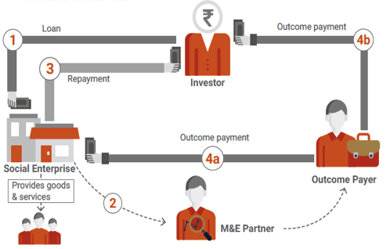
Impact Linked Debt
Social Success Notes
Soft Loans with Guarantees
A loan given to a for-profit social enterprise where interest subvention is offered by philanthropic capital if pre-determined impact objectives are met at the end of the intervention
A loan given to a for-profit social enterprise which is back-stopped by philanthropic capital; outcome achievement is incentivised through performance-linked payments
Beneficiaries
Outcome Funder
Goods & Services
Principal Guarantee
Soft Loan
Social Enterprise
Risk Investor
Repays Loan

